Slide 1
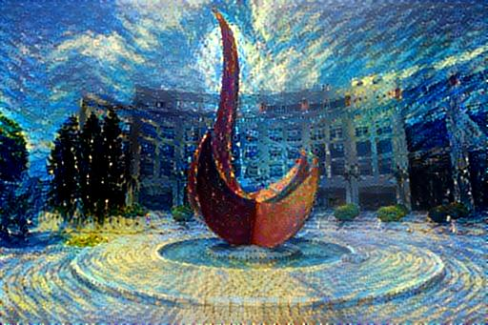
Capstone Project for Data Science
Yuan YAO
HKUST

Slide 2
Course Infomation
Course web:
https://yao-lab.github.io/capstone/2021.fall/
Time and Venure:
Lecture: TuTh, 3:00-4:20pm
Rm 5510, Lift 25-26, Zoom Meetings from CANVAS
Tutorial: Mon 1:30-2:20pm? -> Thurs. 18-18:50pm
to-be-changed
Instructor:
Yuan Yao < yuany@ust.hk > (https://yao-lab.github.io/)
Teaching Assistant:
LIANG, Zhicong <zliangak@connect.ust.hk>

Slide 3
Course Requirement
Prerequisite: (Statistical) Machine Learning, e.g. working knowledge about linear regression, classification, logistic regression, decision trees (CART), boosting, random forests, support vector machines, neural networks
With these, you can pursue basic projects in this class
Advanced project needs convolutional Neural Networks

Slide 4
Projects:
Basic level:
Kaggle Contest: Home Credit Default Risk
https://www.kaggle.com/c/home-credit-default-risk/overview
Advanced level:
Kaggle contest: Nexperia Image Classification
https://www.kaggle.com/c/semi-conductor-image-classification-first
Team works are encouraged!
Let’s introduce each other…

Slide 5
A Brief History of AI, Machine Learning, and Deep Learning

Slide 6
Artificial Intelligence, Machine Learning, and Deep Learning
AI is born in 1950s, when a handful of pioneers from the nascent field of computer science started asking whether computers could be made to “think”—a question whose ramifications we’re still exploring today.

Slide 7
Machine Learning is a new paradigm of computer programming
During 1950s-1980s, two competitive ideas of realizing AI exist
Rule based inference, or called Expert System
Statistics based inference, or called Machine Learning
1990s- Machine Learning becomes dominant

Slide 8
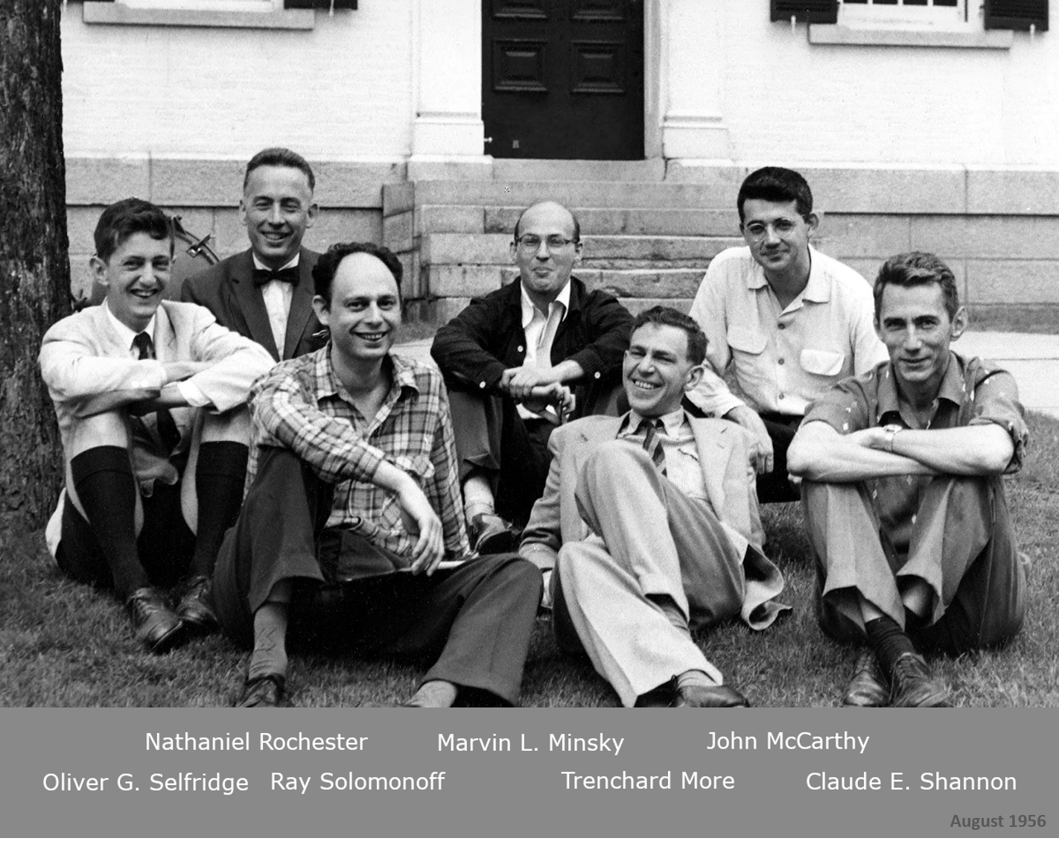
A brief history of AI
1943: McCulloch & Pits proposed a boolean circuit model of neurons
1949: Donald Hebb proposed Hebbian learning rule.
1950: Alan Turing published "Computing Machinery and Intelligence" with Turing test.
1956: John McCarthy at the Dartmouth Conference coined terminology "Artificial Intelligence”
1957: Rosenblatt invented Perceptron
1960s: golden years till 1969 Minsky-Papert’s critical book Perceptron
1970s: the first AI winter
1980s: boom of AI with Expert System
1990s: the second AI winter, rise of statistical machine learning
1997: IBM Deep Blue beats world chess champion Kasparov
2012: return of neural networks as deep learning (speech, ImageNet in computer vision, NLP, …)
2016-2017: Google AlphaGo “Lee” and Zero
2020: Google AlphaFold
…

Slide 9

History of A.I.
“Deep Learning”
Neural Networks
Statistical Machine Learning
“In the first wave of AI you had to be a programmer. In the second wave of AI you have to be a data scientist. The third wave of AI — the more moral you are, the better.”
Expert System
AI, Perceptron
1956
1980
2000
2010
Source: Dr. Lee Kai-Fu • Sinovation Ventures and 2018 Conference on Neural Information Processing Systems

Slide 10
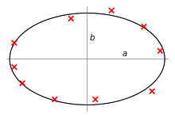
The 1st machine learning method: Least Squares
Invention:
Carl Friederich Gauss (~1795/1809/1810),
Adrien-Marie Legendre (1805)
Robert Adrain (1808)
Application:
Prediction of the location of asteroid Ceres after it emerged from behind the sun (Franz Xaver von Zach 1801)
Orbits of planets, Newton Laws
Statistics,
…

Slide 11
The 1st neural network: Perceptron

Slide 12
The Perceptron Algorithm for classification
The Perceptron Algorithm is a Stochastic Gradient Descent method (Robbins-Monro 1951):

Slide 13
Finiteness of Stopping Time and Margin
Input ball:
Margin:

Slide 14
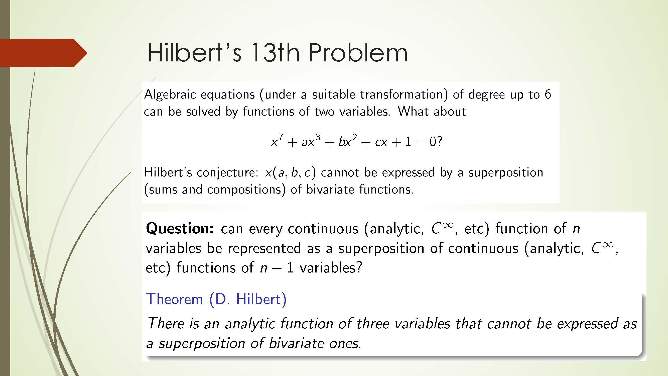

Slide 17
A Simplified illustration by David McAllester

Slide 18
Universal Approximate Representation [Cybenko’1989, Hornik et al. 1989, Poggio-Girosi’1989, ...]
Complexity (regularity, smoothness) thereafter becomes the central pursuit in Approximation Theory.

Slide 22
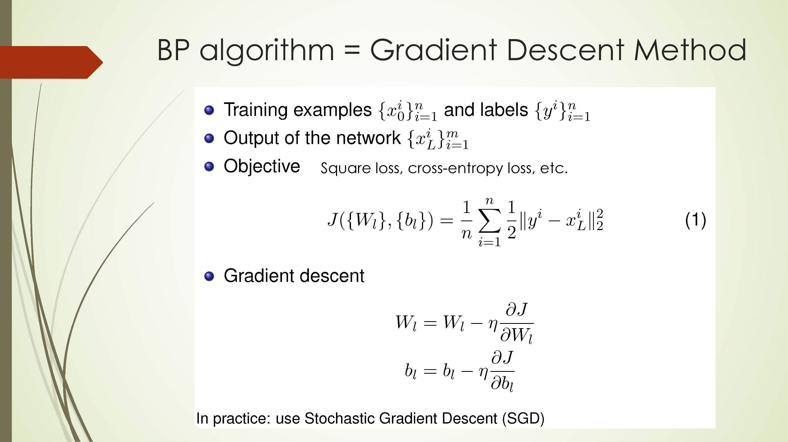

Slide 23
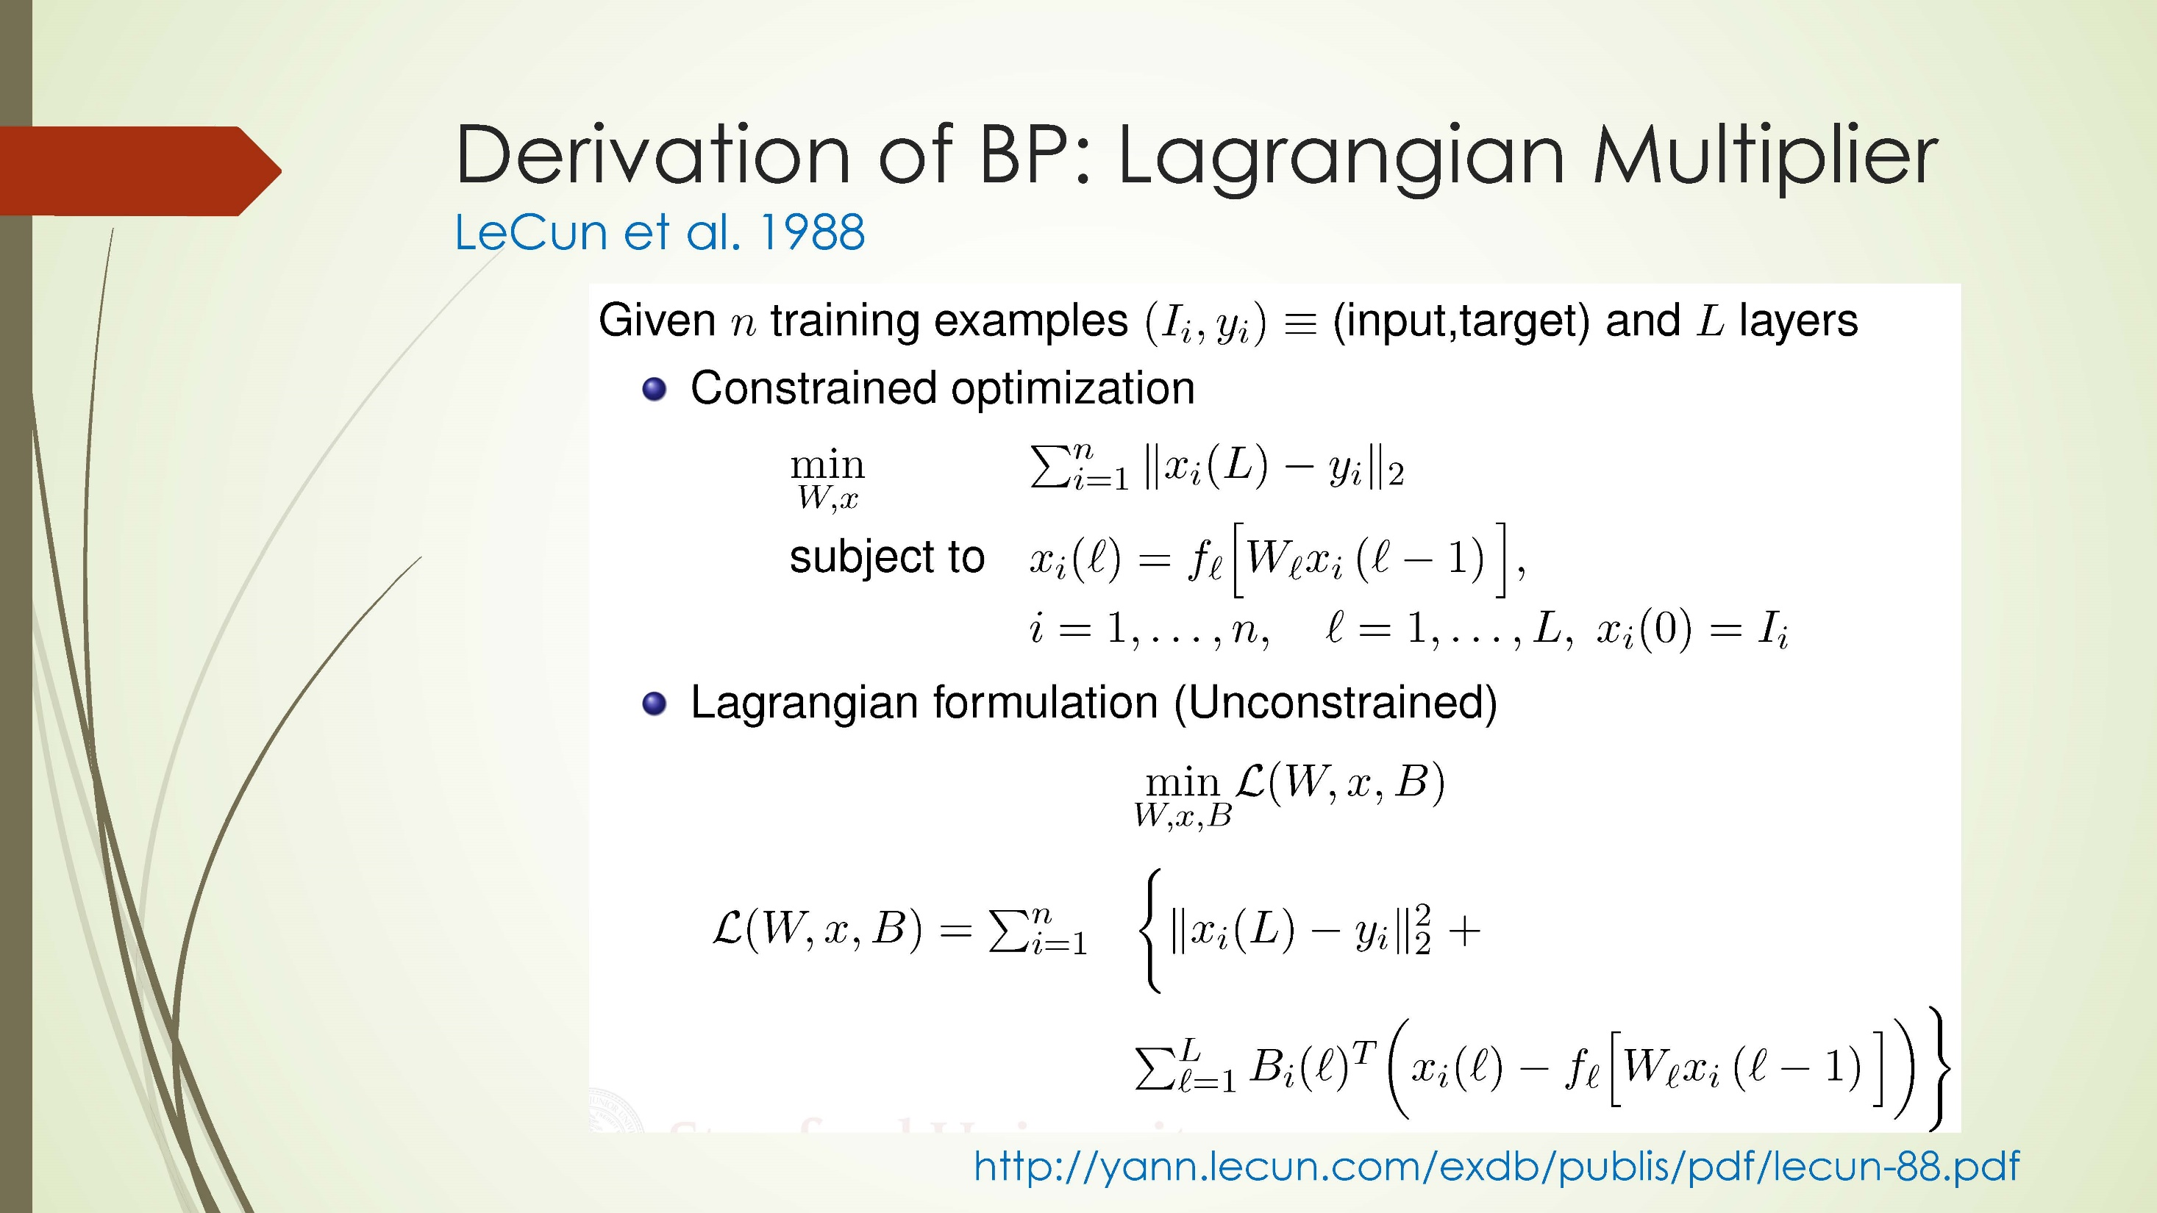

Slide 24
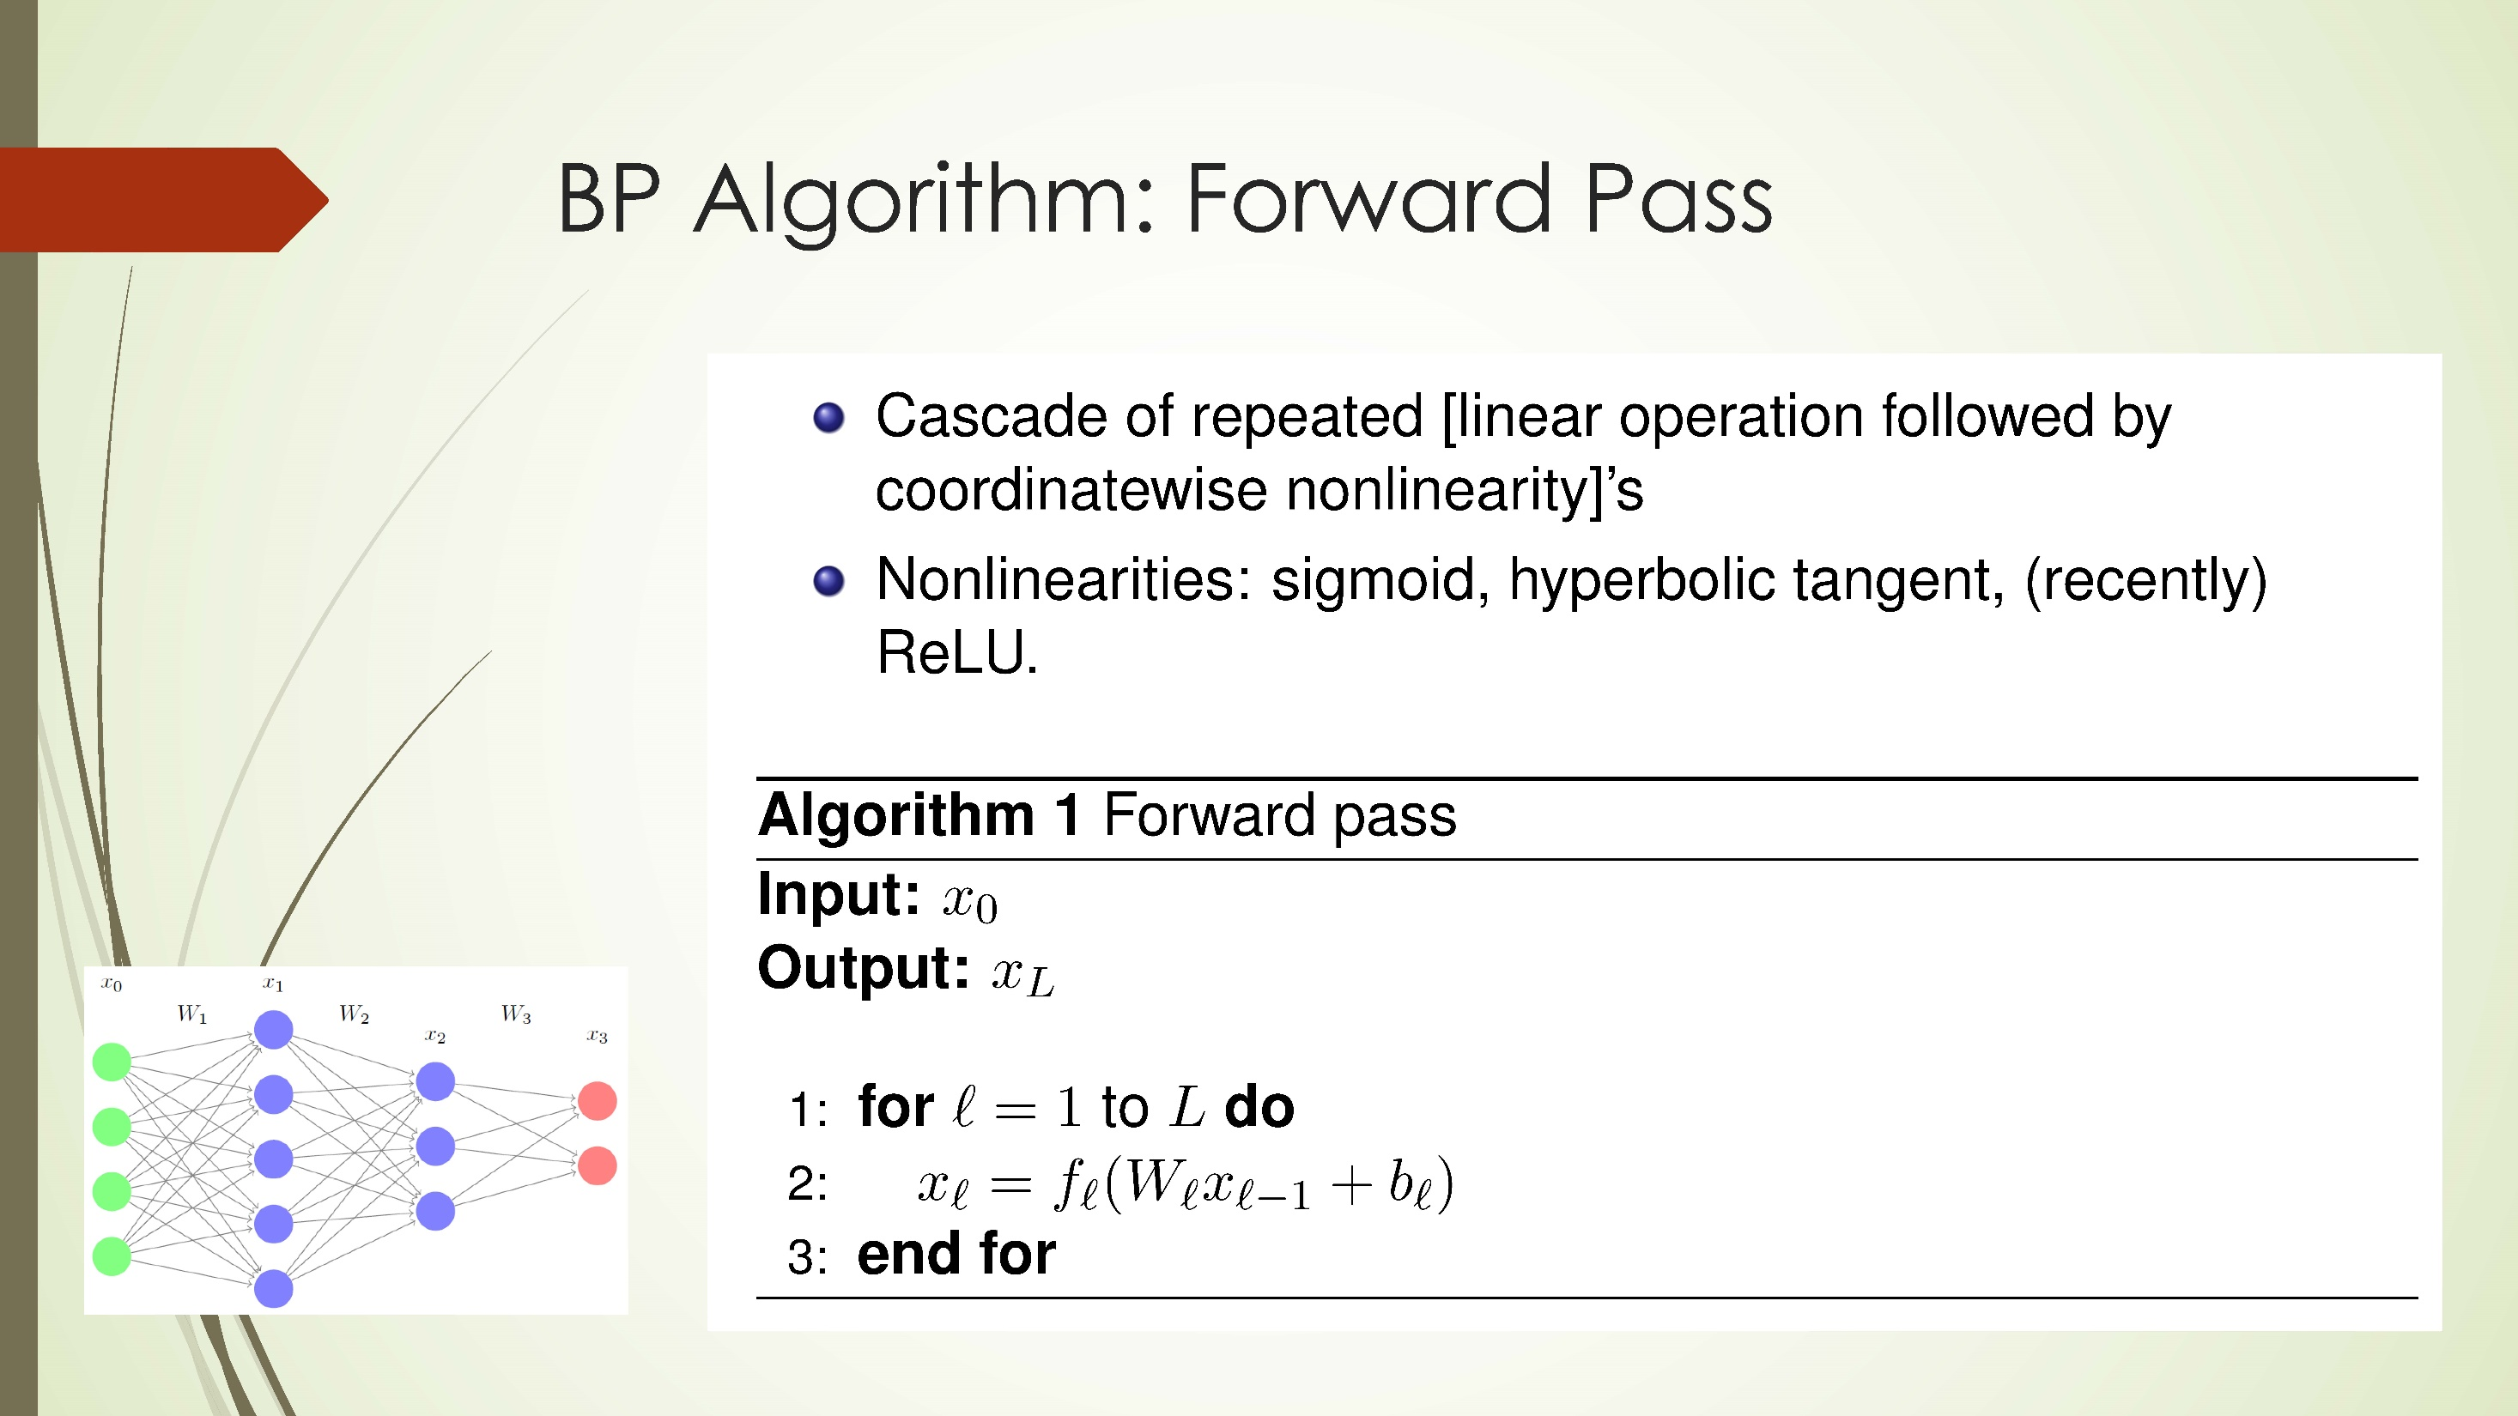

Slide 25
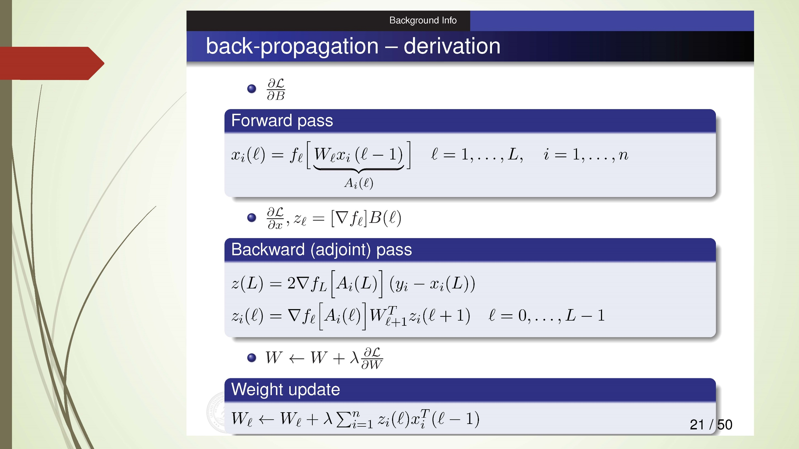

Slide 26
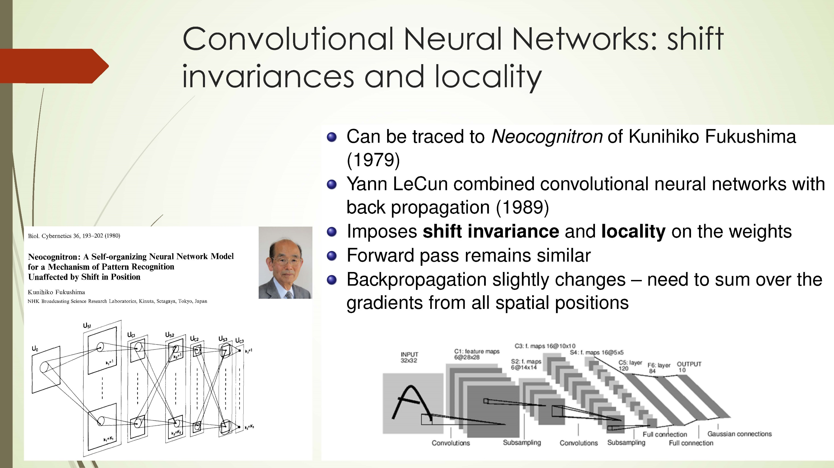

Slide 27
Linear Dynamical Systems (1940s-)
time →
The hidden state has linear dynamics with Gaussian noise and produces the observations using a linear model with Gaussian noise.
Kalman Filter: A linearly transformed Gaussian is a Gaussian. So the distribution over the hidden state given the data so far is Gaussian. It can be computed using “Kalman filtering”.
To predict the next output (so that we can shoot down the missile) we need to infer the hidden state.
output
output
output
hidden
hidden
hidden
driving input
driving input
driving input

Slide 28
Hidden Markov Models (1970s-)
Hidden Markov Models have a discrete one-of-N hidden state. Transitions between states are stochastic and controlled by a transition matrix. The outputs produced by a state are stochastic.
We cannot be sure which state produced a given output. So the state is “hidden”.
It is easy to represent a probability distribution across N states with N numbers.
To predict the next output we need to infer the probability distribution over hidden states.
HMMs have efficient algorithms (Baum-Welch or EM Algorithm) for inference and learning.
Jim Simons hires Lenny Baum as the founding member of Renaissance Technologies in 1979
output
output
output
time →

Slide 29
Recurrent Neural Networks (1986-)
The issue of a hidden Markov model (HMM):
At each time step it must select one of its hidden states. So with N hidden states it can only remember log(N) bits about what it generated so far.
RNNs are very powerful, because they combine two properties:
Distributed hidden state that allows them to store a lot of information about the past efficiently.
Non-linear dynamics that allows them to update their hidden state in complicated ways.
Rumelhart et al. enables training by BP algorithm
With enough neurons and time, RNNs can compute anything that can be computed by your computer.

Slide 30
Long-Short-Term-Memory (LSTM)
Sepp Hochreiter; Jürgen Schmidhuber (1997). "Long short-term memory". Neural Computation. 9 (8): 1735–1780. (https://www.bioinf.jku.at/publications/older/2604.pdf)
Introduction of short path to learn deep networks without vanishing gradient problem.

Slide 32
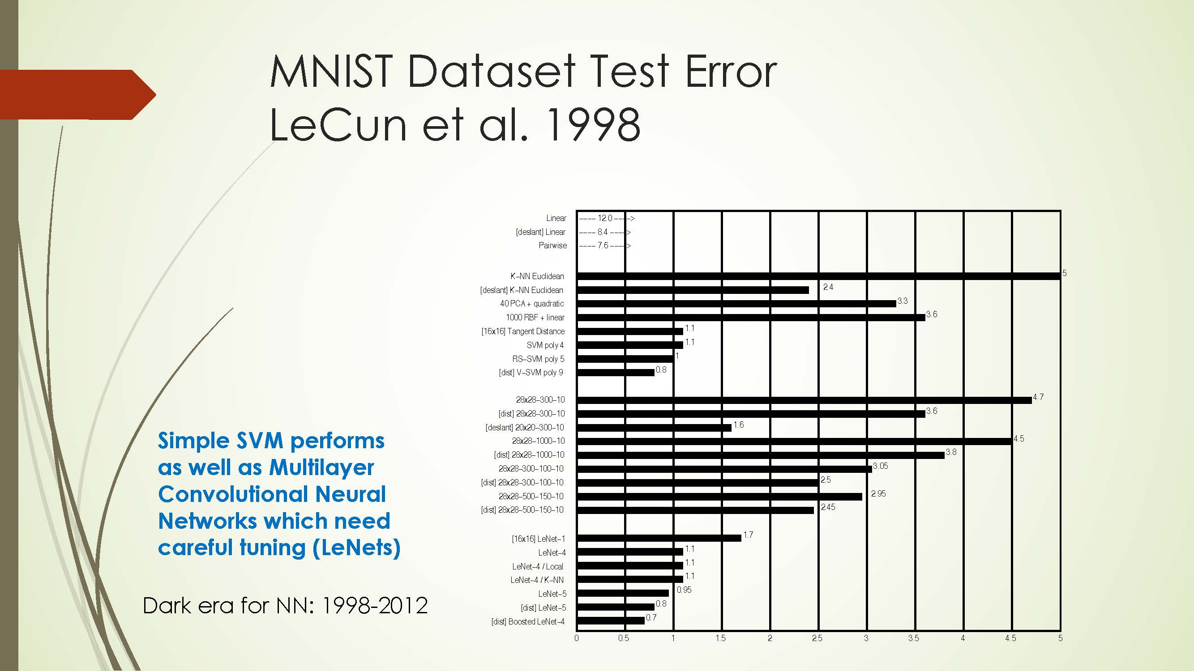


Slide 33
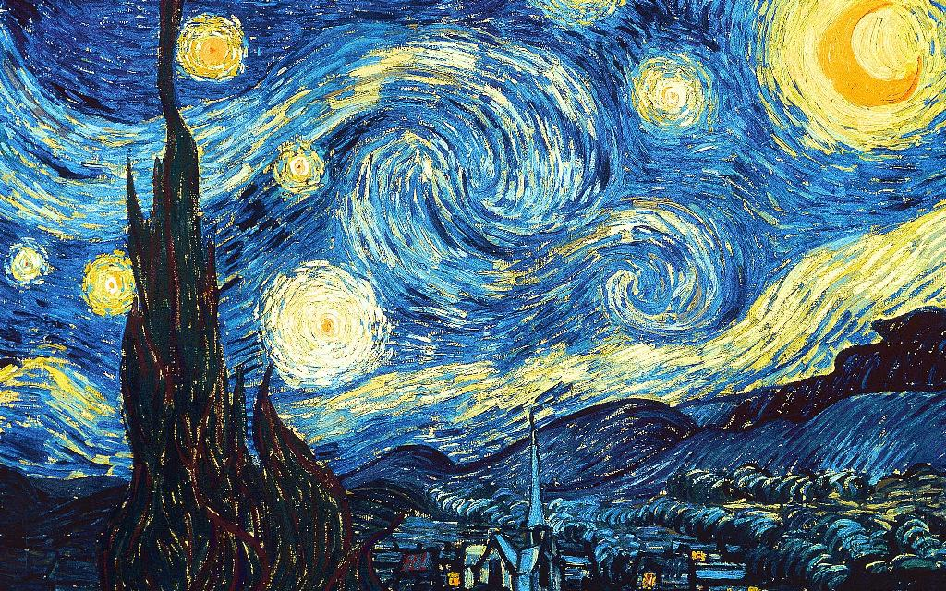
2000-2010: The Era of SVM, Boosting, … as nights of Neural Networks

Slide 34
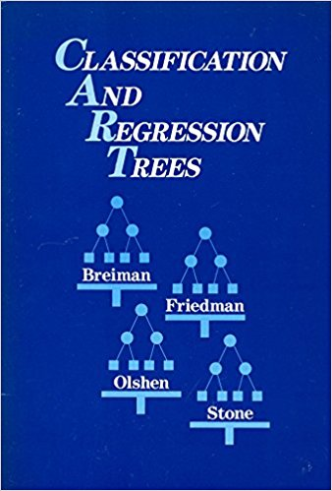
Decision Trees and Boosting
Breiman, Friedman, Olshen, Stone, (1983): CART
``The Boosting problem‘’ (M. Kearns & L. Valiant): Can a set of weak learners create a single strong learner? (三个臭皮匠顶个诸葛亮？)
Breiman (1996): Bagging
Freund, Schapire (1997): AdaBoost (“the best off-the-shelf algorithm” by Breiman)
Breiman (2001): Random Forests

Slide 35
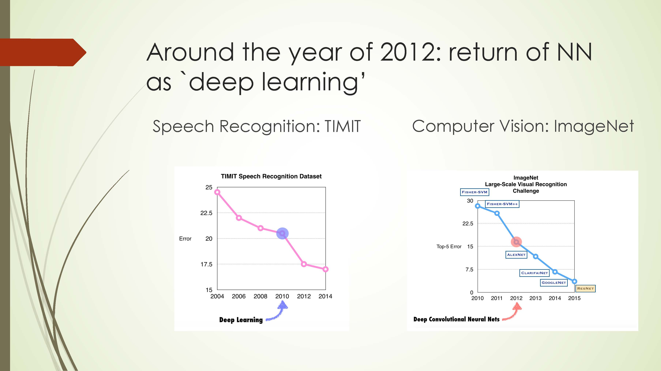

Slide 36
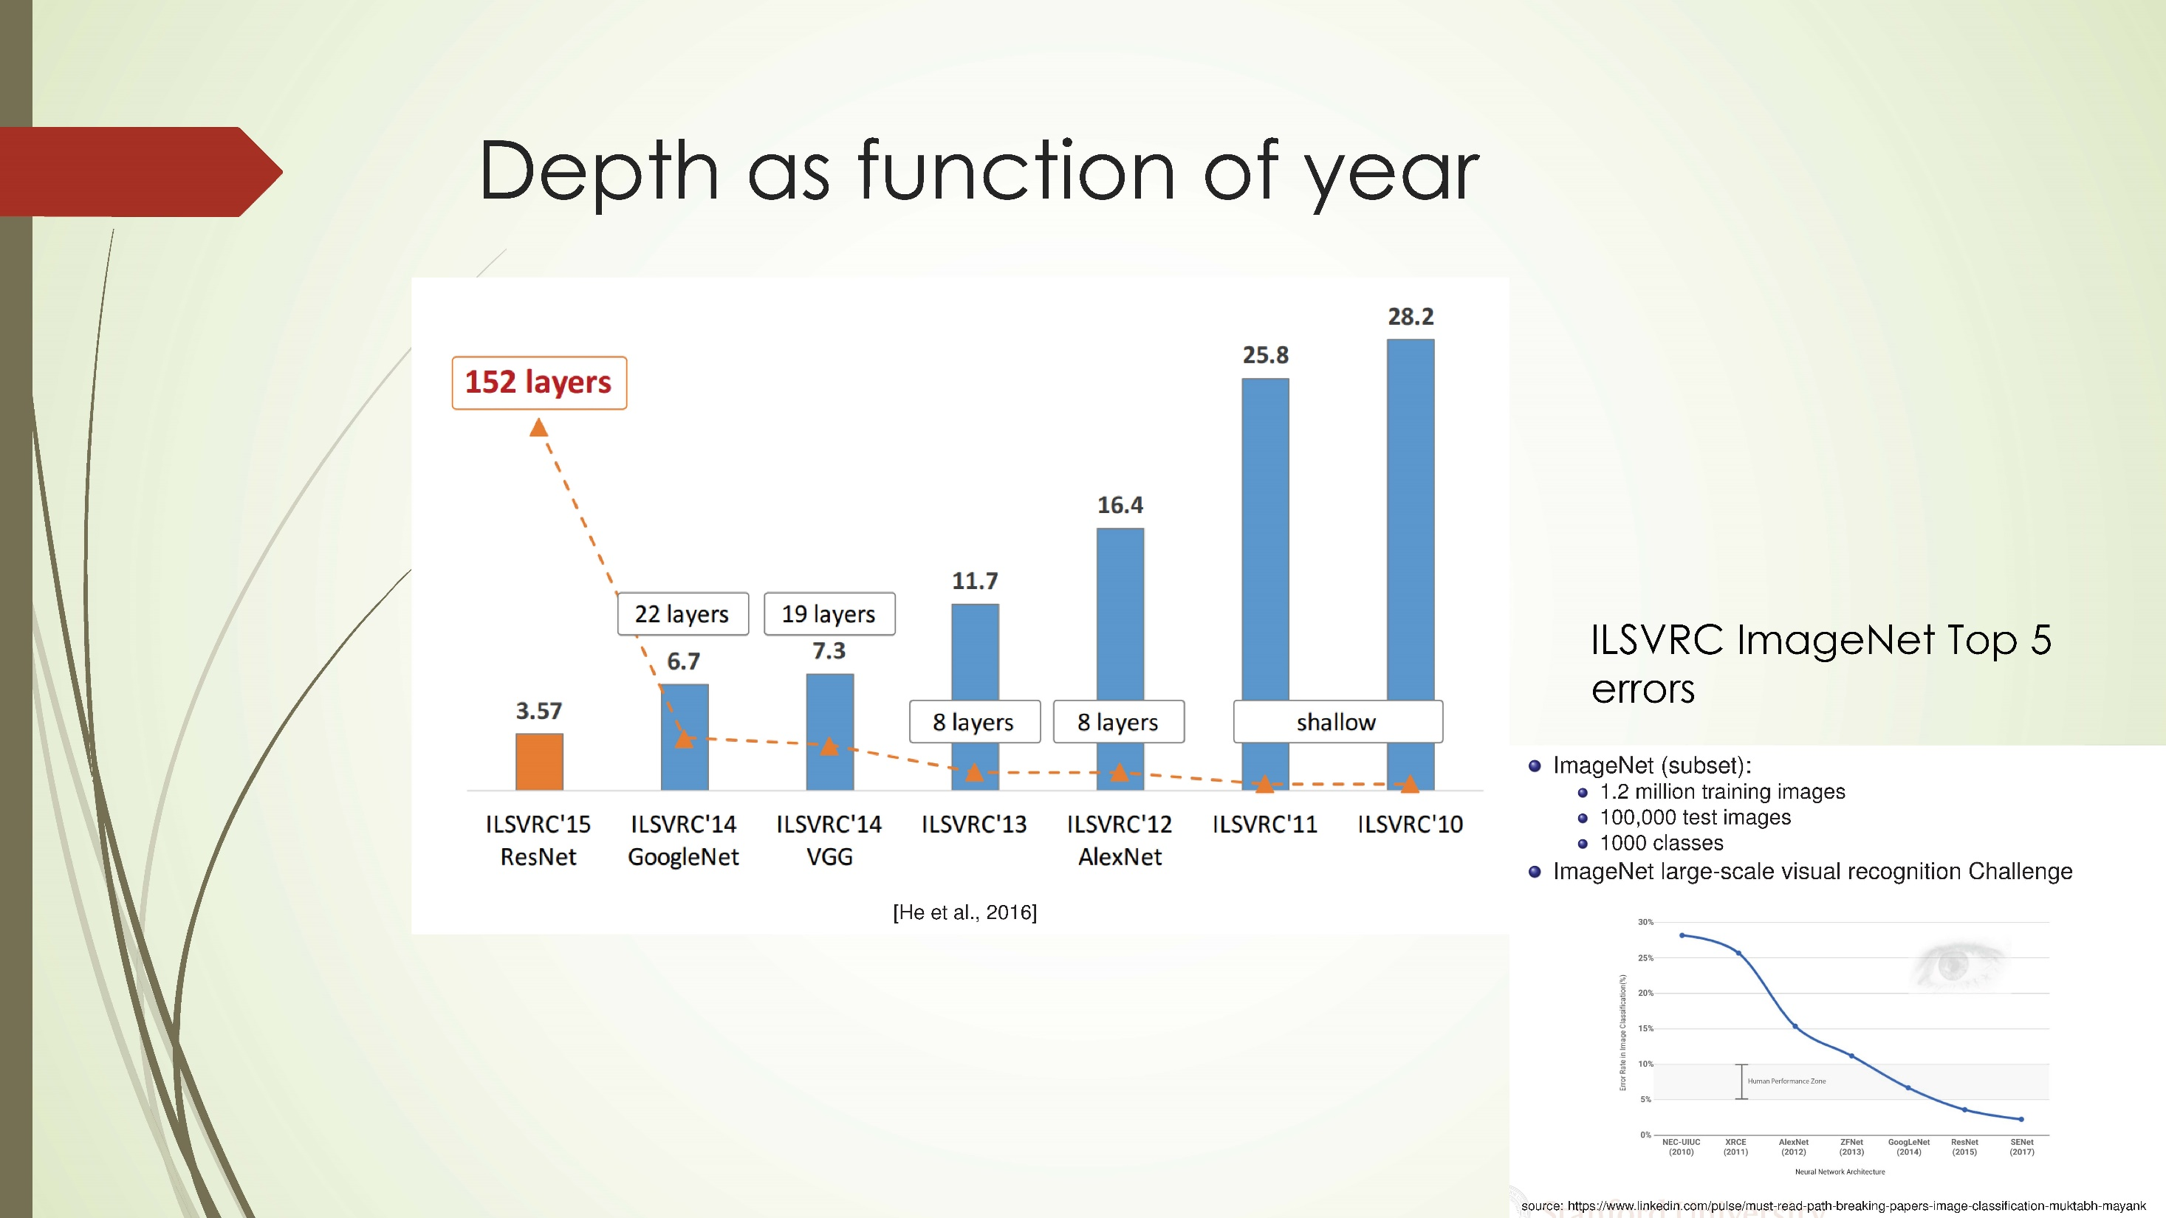

Slide 37
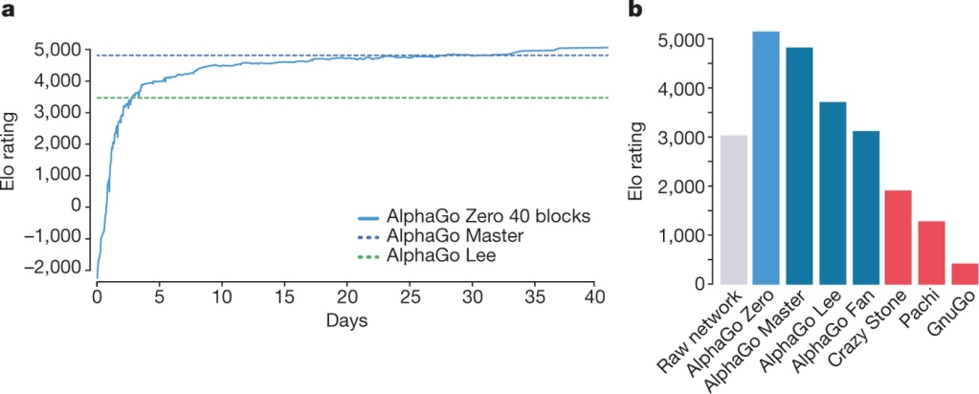
Reaching Human Performance Level in Games
AlphaGo “LEE” 2016
Deep Blue in 1997
AlphaGo ”ZERO” D Silver et al. Nature 550, 354–359 (2017) doi:10.1038/nature24270

Slide 38
NLP and Machine Translation
In 2013-2015, LSTMs started achieving state-of-the-art results
Successful tasks include: handwriting recognition, speech
recognition, machine translation, parsing, image captioning
LSTM became the dominant approach
In 2019, other approaches (e.g. Transformers) have become more dominant for certain tasks.
For example in WMT (a MT conference + competition):
In WMT 2016, the summary report contains ”RNN” 44 times
In WMT 2018, the report contains “RNN” 9 times and “Transformer” 63 times
Source: "Findings of the 2016 Conference on Machine Translation (WMT16)", Bojar et al. 2016, http://www.statmt.org/wmt16/pdf/W16-2301.pdf
Source: "Findings of the 2018 Conference on Machine Translation (WMT18)", Bojar et al. 2018, http://www.statmt.org/wmt18/pdf/WMT028.pdf

Slide 39
Number of AI papers on arXiv, 2010-2019

Slide 40
Growth of Deep Learning
‘Deep Learning’ is coined by Hinton et al. in their Restricted Boltzman Machine paper, Science 2006, not yet popular until championing ImageNet competitions.

Slide 41
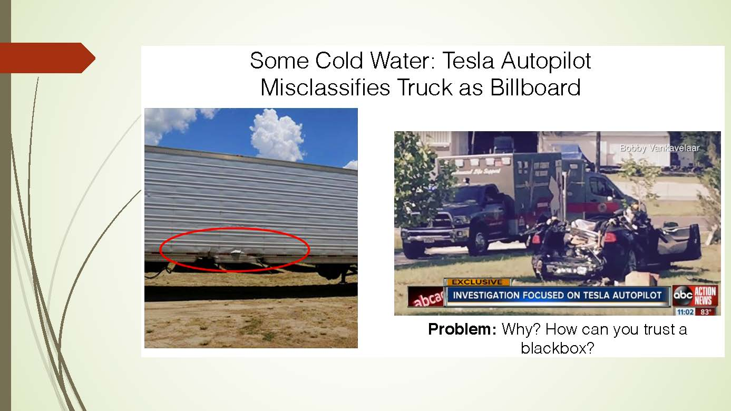

Slide 42
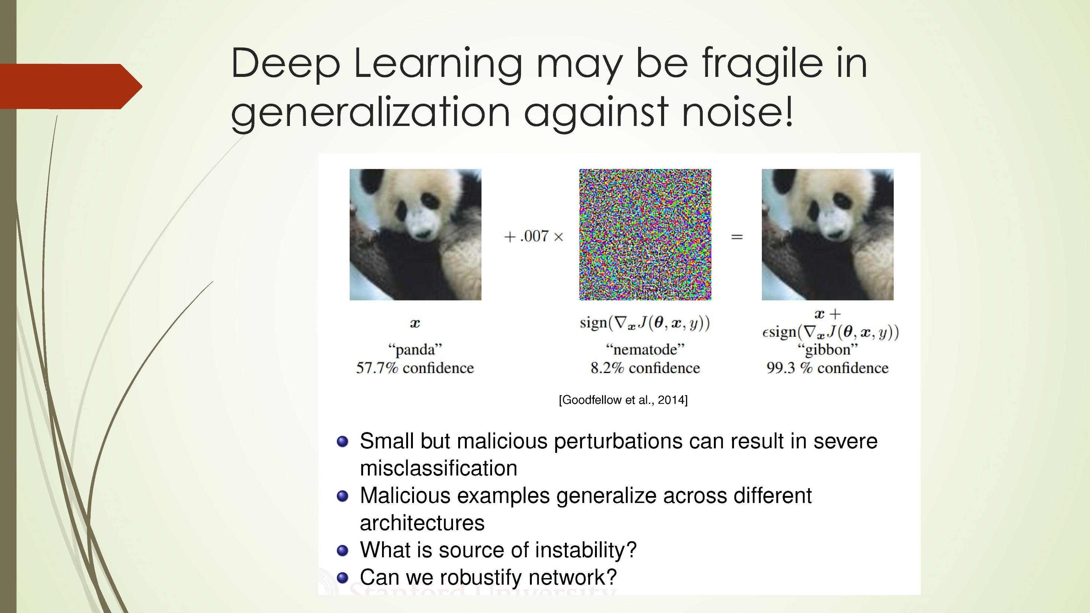

Slide 45
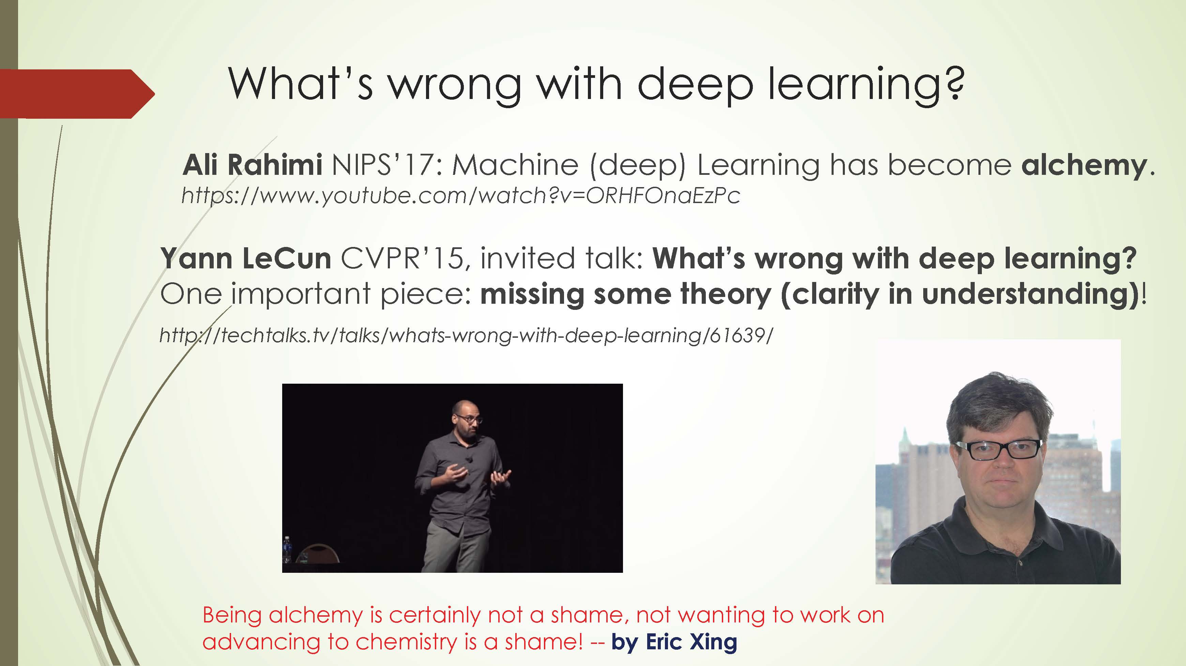

Slide 47
In this class
Understand its principles: statistics, optimization
Analyze the real world data with the methods
Team-work (no more than 3 persons per team)!

Slide 48
Thank you!

